Slide 1
أهمية التحليل الإحصائي
د. باسم بن صالح الصاعدي

Slide 2
الهدف الأول: تصوير البيانات للمساعدة في إتخاذ القرار

Slide 3
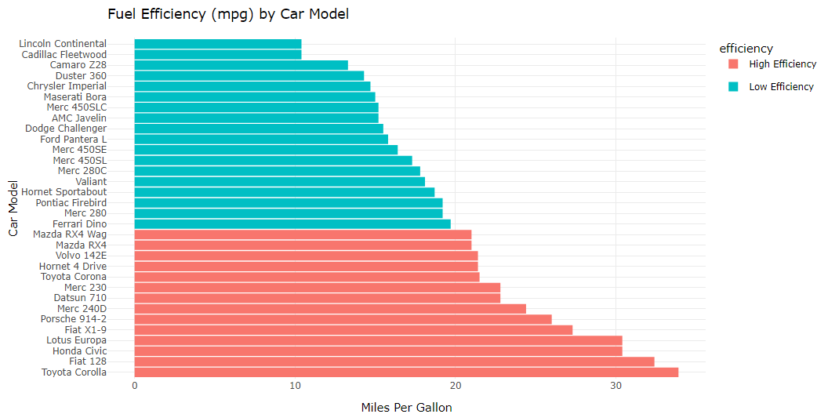
Fuel Efficiency

Slide 4
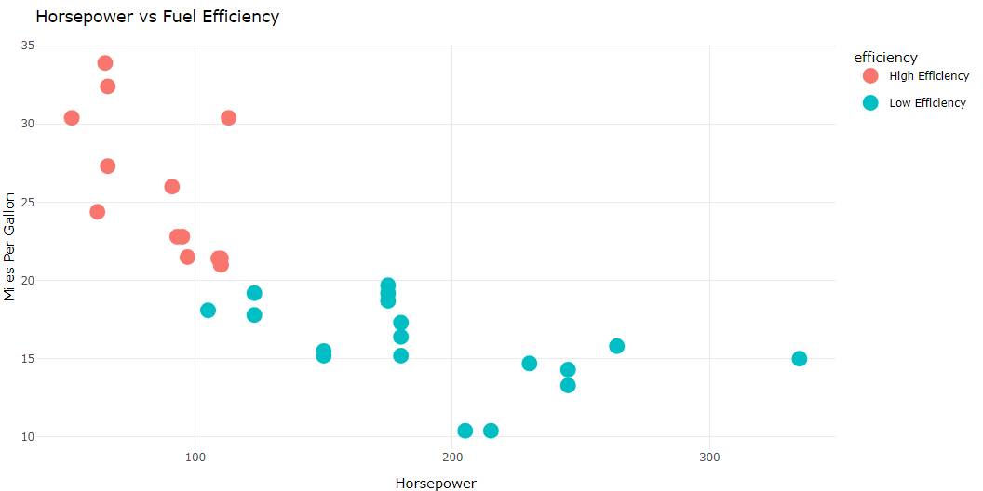
Horsepower

Slide 5
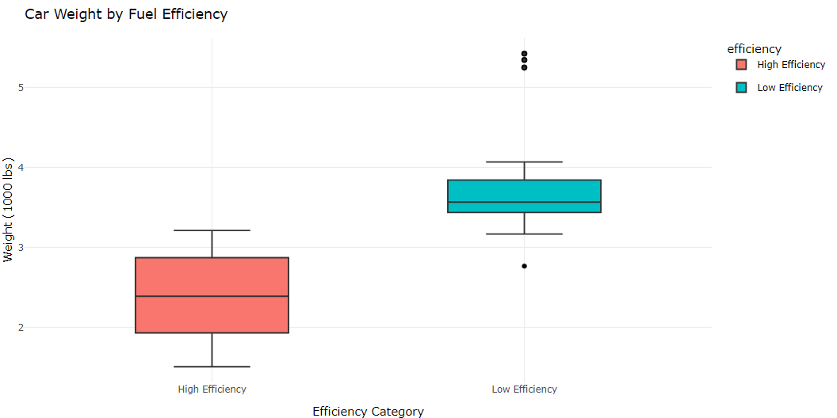
Weight

Slide 7
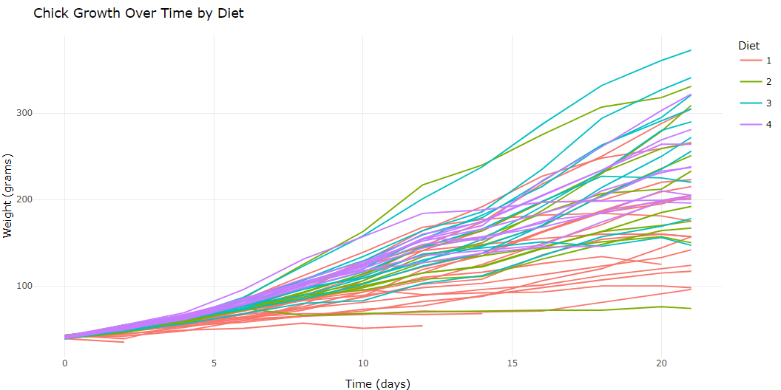
weight over time for each diet

Slide 8
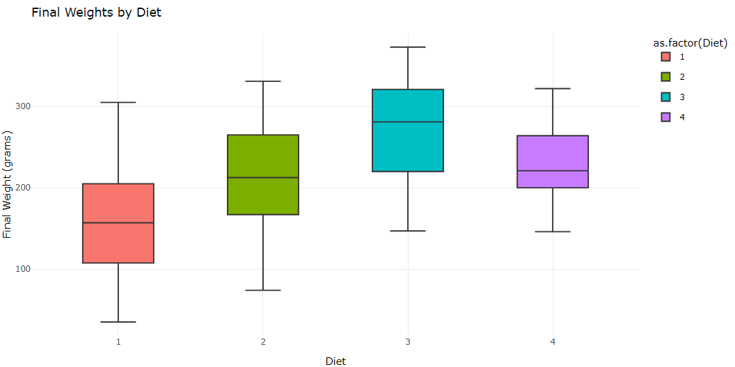
Final Weights by Diet

Slide 9
Average Weight Gain by Diet
# A tibble: 4 × 2 Diet Average_Weight_Gain <fct> <dbl> 1 3 143. 2 4 135. 3 2 123. 4 1 103.

Slide 10
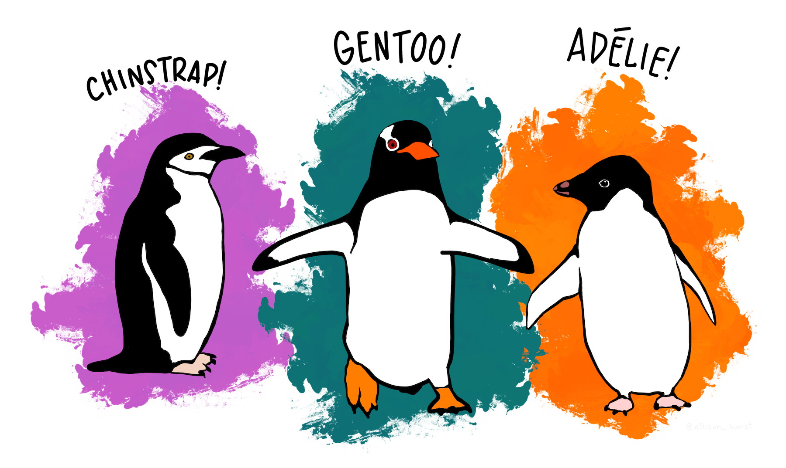
الهدف الثاني: إستكشاف البيانات
Palmer Penguins Dataset

Slide 11
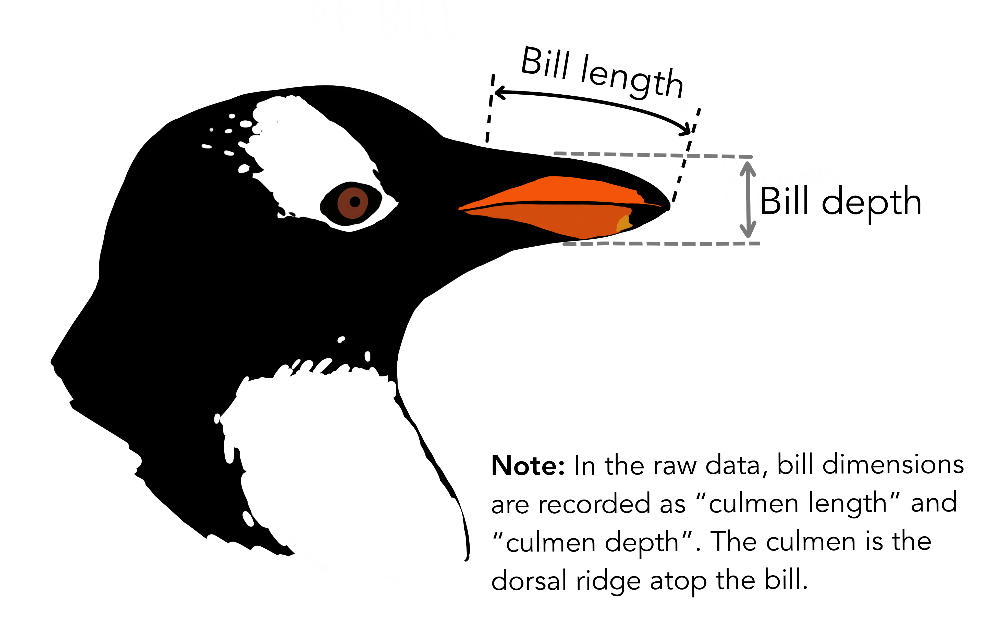
# A tibble: 6 × 8 species island bill_length_mm bill_depth_mm flipper_length_mm body_mass_g <fct> <fct> <dbl> <dbl> <int> <int> 1 Adelie Torgersen 39.1 18.7 181 3750 2 Adelie Torgersen 39.5 17.4 186 3800 3 Adelie Torgersen 40.3 18 195 3250 4 Adelie Torgersen NA NA NA NA 5 Adelie Torgersen 36.7 19.3 193 3450 6 Adelie Torgersen 39.3 20.6 190 3650 # ℹ 2 more variables: sex <fct>, year <int>
Summary

Slide 12
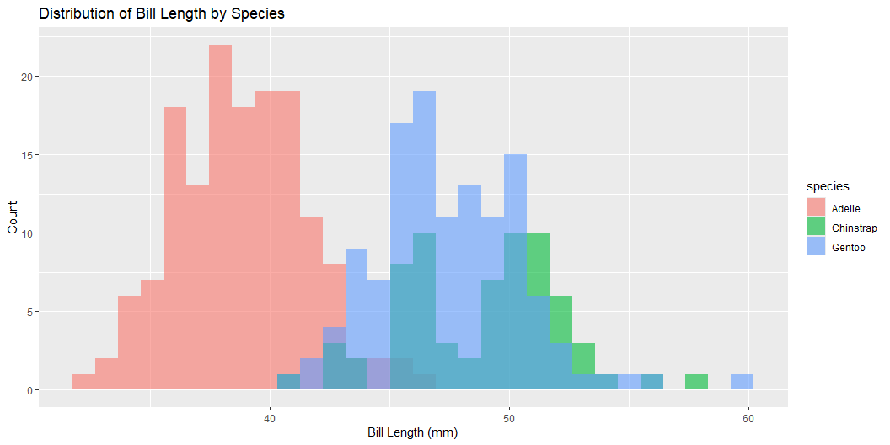
species island bill_length_mm bill_depth_mm Adelie :152 Biscoe :168 Min. :32.10 Min. :13.10 Chinstrap: 68 Dream :124 1st Qu.:39.23 1st Qu.:15.60 Gentoo :124 Torgersen: 52 Median :44.45 Median :17.30 Mean :43.92 Mean :17.15 3rd Qu.:48.50 3rd Qu.:18.70 Max. :59.60 Max. :21.50 NA's :2 NA's :2 flipper_length_mm body_mass_g sex year Min. :172.0 Min. :2700 female:165 Min. :2007 1st Qu.:190.0 1st Qu.:3550 male :168 1st Qu.:2007 Median :197.0 Median :4050 NA's : 11 Median :2008 Mean :200.9 Mean :4202 Mean :2008 3rd Qu.:213.0 3rd Qu.:4750 3rd Qu.:2009 Max. :231.0 Max. :6300 Max. :2009 NA's :2 NA's :2
Missing Data
species island bill_length_mm bill_depth_mm 0 0 2 2 flipper_length_mm body_mass_g sex year 2 2 11 0
Bill Length

Slide 13
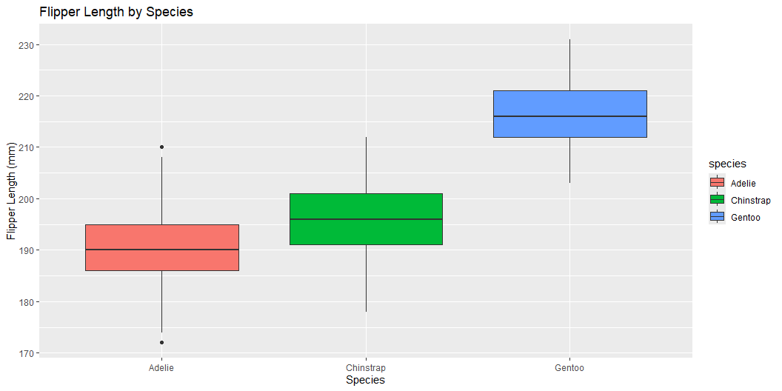
Flipper Length by Species

Slide 14
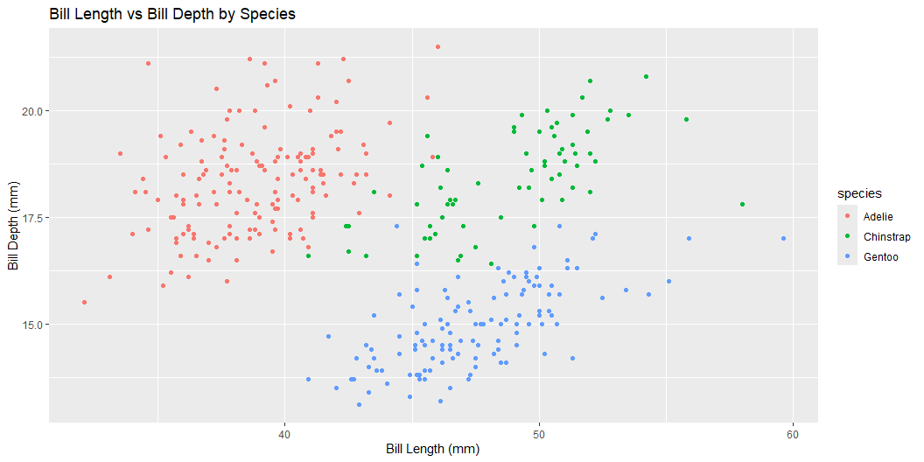
Bill Length vs Bill Depth

Slide 15
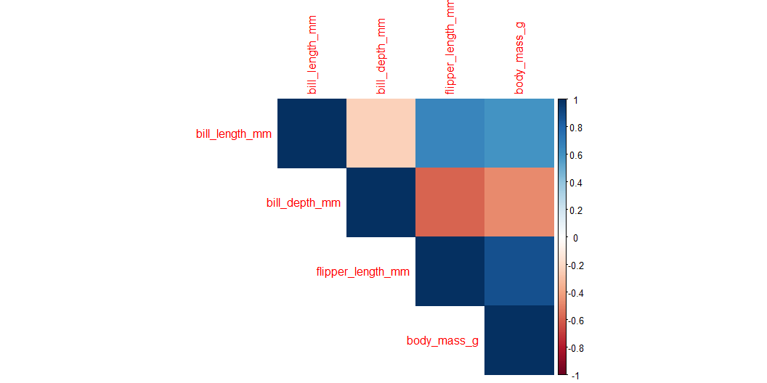
Relationships Between Variables

Slide 16
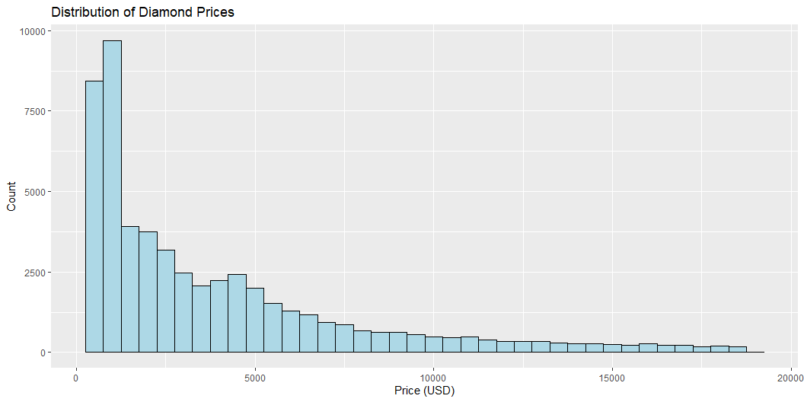
بيانات الألماس
Data
# A tibble: 6 × 10 carat cut color clarity depth table price x y z <dbl> <ord> <ord> <ord> <dbl> <dbl> <int> <dbl> <dbl> <dbl> 1 0.23 Ideal E SI2 61.5 55 326 3.95 3.98 2.43 2 0.21 Premium E SI1 59.8 61 326 3.89 3.84 2.31 3 0.23 Good E VS1 56.9 65 327 4.05 4.07 2.31 4 0.29 Premium I VS2 62.4 58 334 4.2 4.23 2.63 5 0.31 Good J SI2 63.3 58 335 4.34 4.35 2.75 6 0.24 Very Good J VVS2 62.8 57 336 3.94 3.96 2.48
Missing Data
carat cut color clarity depth table price x y z 0 0 0 0 0 0 0 0 0 0
Diamond Prices

Slide 17
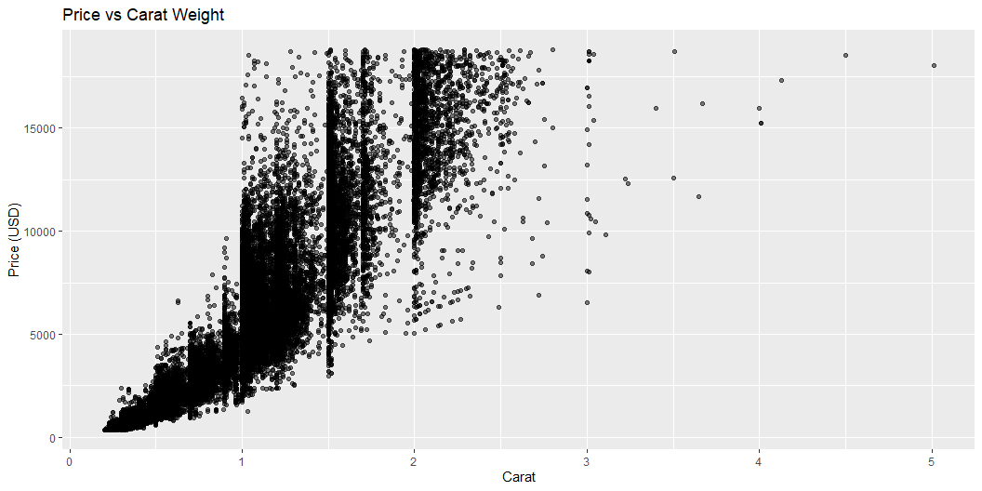
Price vs Carat:

Slide 18
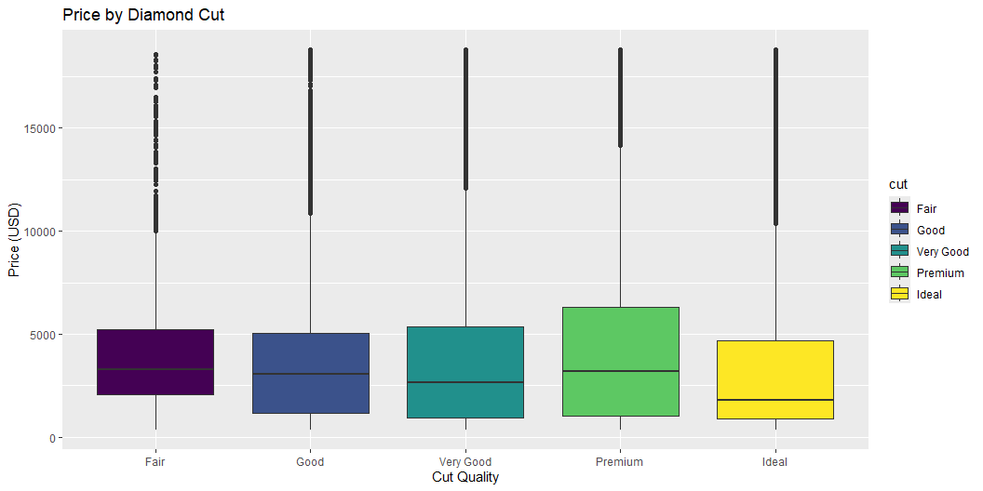
Price by Cut Quality

Slide 19
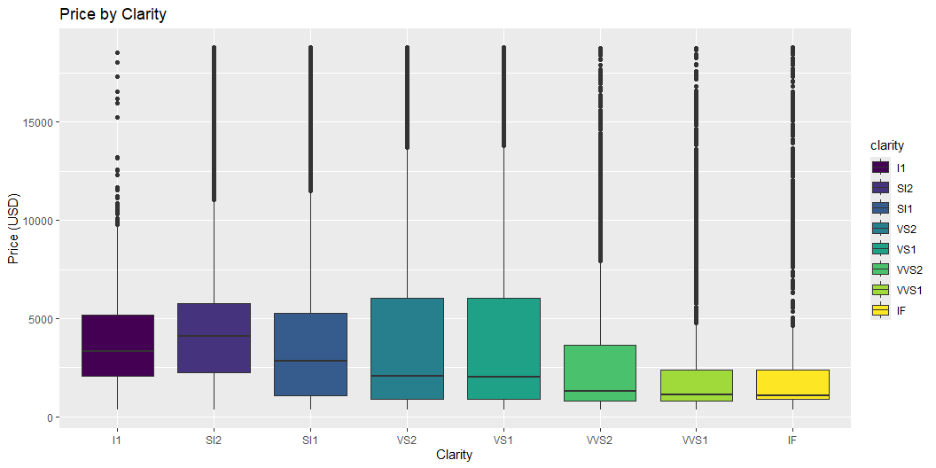
Price by Clarity

Slide 20
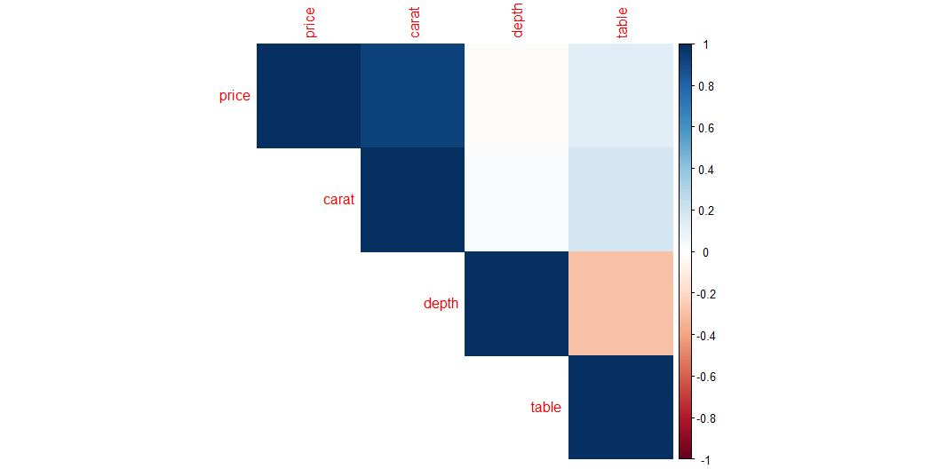
Relationships Between Variables

Slide 21
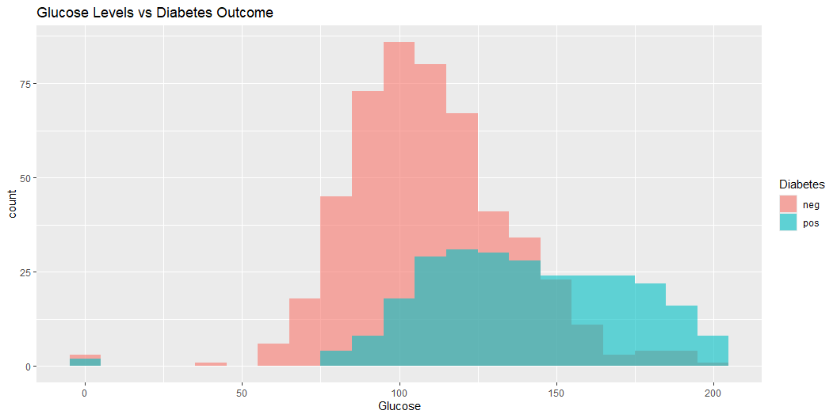
الهدف الثالث: معرفة العوامل المؤثرة على متغير
Heart Disease Dataset
pregnant glucose pressure triceps insulin mass pedigree age diabetes 1 6 148 72 35 0 33.6 0.627 50 pos 2 1 85 66 29 0 26.6 0.351 31 neg 3 8 183 64 0 0 23.3 0.672 32 pos 4 1 89 66 23 94 28.1 0.167 21 neg 5 0 137 40 35 168 43.1 2.288 33 pos 6 5 116 74 0 0 25.6 0.201 30 neg
Glucose vs Outcome (Diabetes)

Slide 22
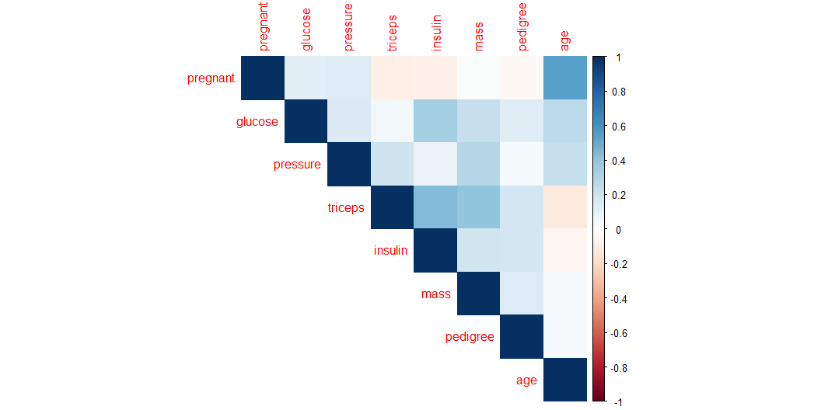
Correlation Matrix

Slide 23
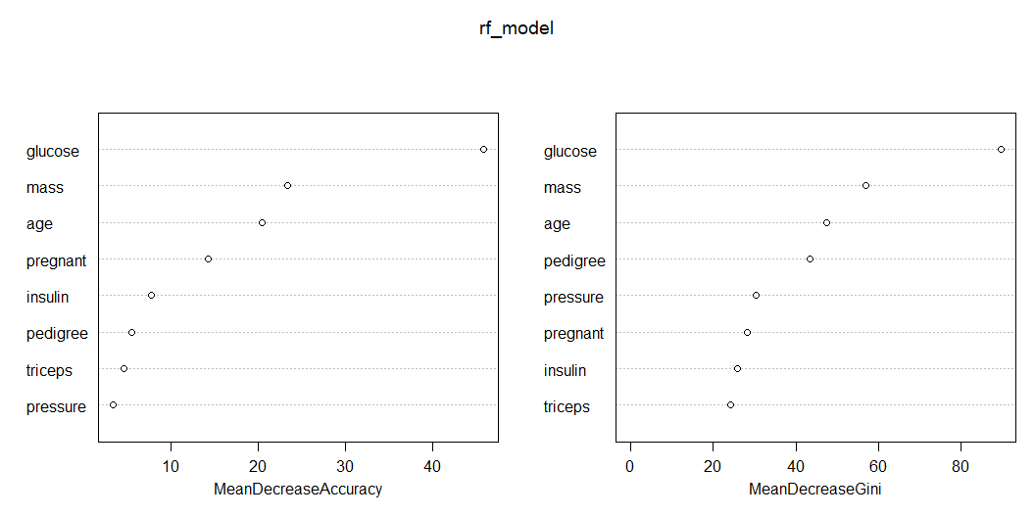
بناء نموذج التصنيف

Slide 24
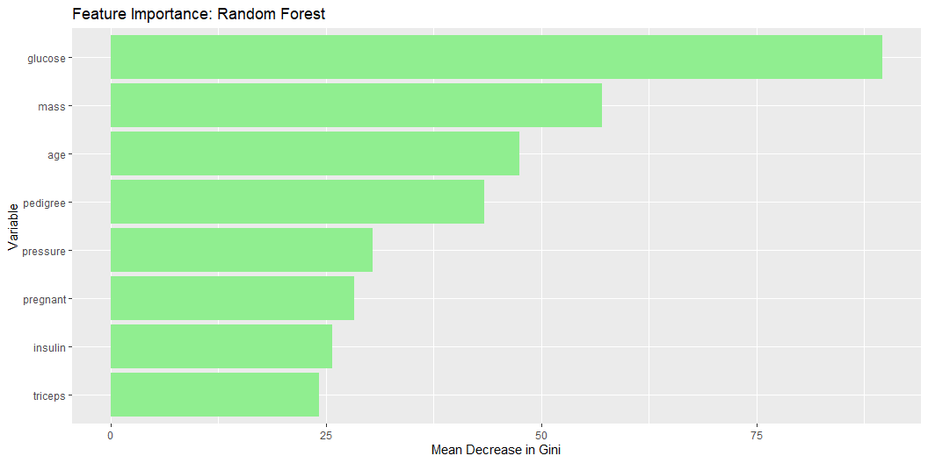
أهم العوامل المؤثرة

Slide 25
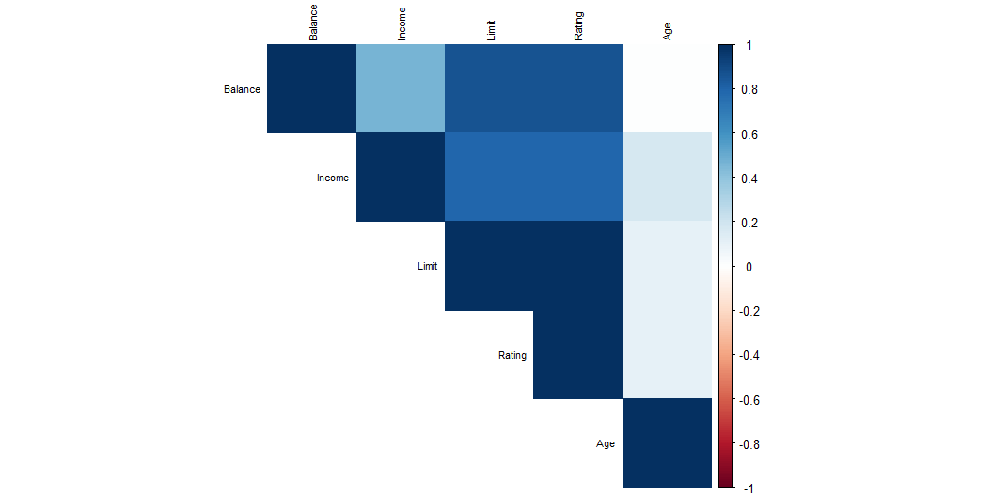
مجموعة بيانات الائتمان
البيانات
ID Income Limit Rating Cards Age Education Gender Student Married Ethnicity 1 1 14.891 3606 283 2 34 11 Male No Yes Caucasian 2 2 106.025 6645 483 3 82 15 Female Yes Yes Asian 3 3 104.593 7075 514 4 71 11 Male No No Asian 4 4 148.924 9504 681 3 36 11 Female No No Asian 5 5 55.882 4897 357 2 68 16 Male No Yes Caucasian 6 6 80.180 8047 569 4 77 10 Male No No Caucasian Balance 1 333 2 903 3 580 4 964 5 331 6 1151
Correlation Matrix

Slide 26
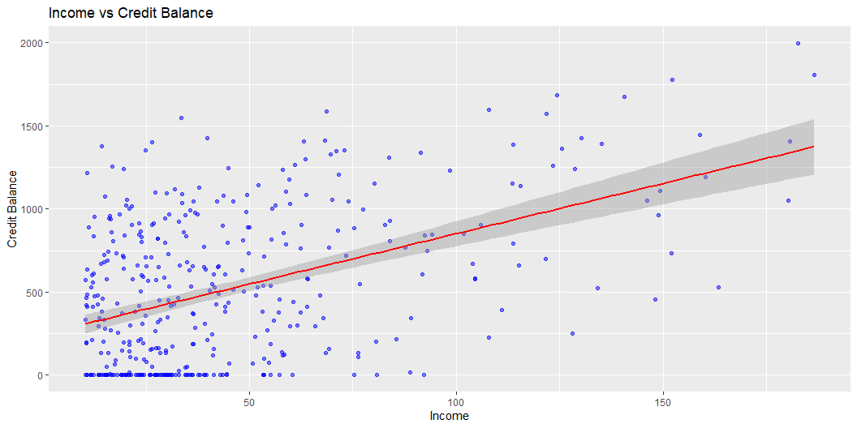
Income vs Balance

Slide 27
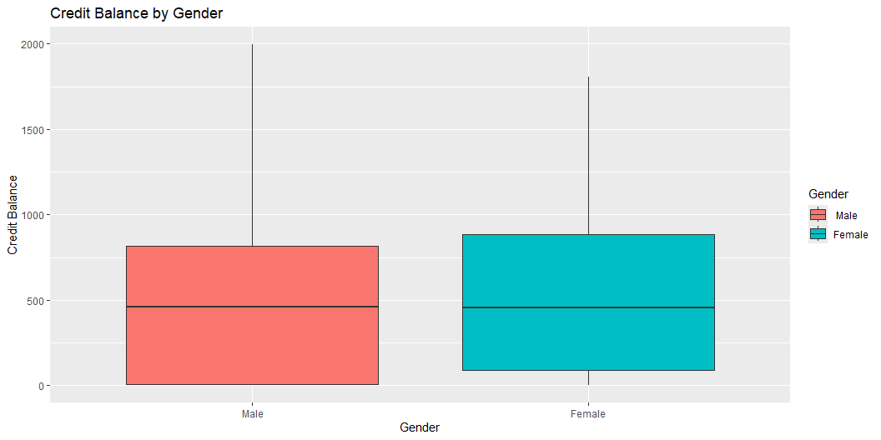
Gender vs Balance

Slide 28
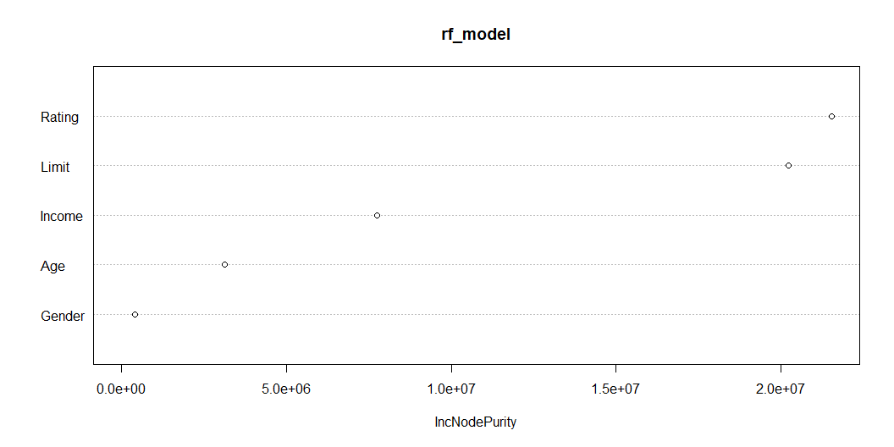
بناء نموذج التصنيف

Slide 29
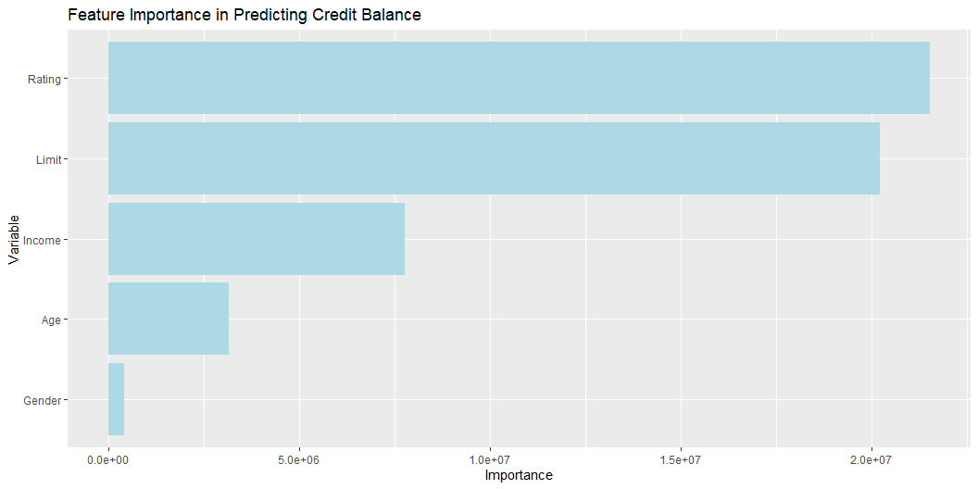
أهم العوامل المؤثرة

Slide 30
الهدف الرابع: التنبؤ

Slide 31
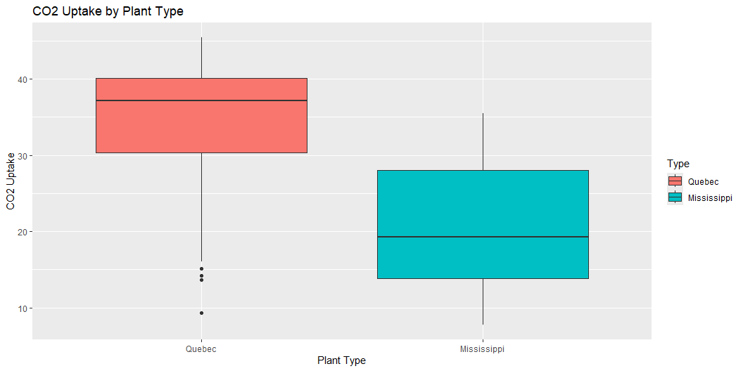
بيانات ثاني أكسيد الكربون
البيانات
Grouped Data: uptake ~ conc | Plant Plant Type Treatment conc uptake 1 Qn1 Quebec nonchilled 95 16.0 2 Qn1 Quebec nonchilled 175 30.4 3 Qn1 Quebec nonchilled 250 34.8 4 Qn1 Quebec nonchilled 350 37.2 5 Qn1 Quebec nonchilled 500 35.3 6 Qn1 Quebec nonchilled 675 39.2
Exploratory Data Analysis
Plant Type Treatment conc uptake Qn1 : 7 Quebec :42 nonchilled:42 Min. : 95 Min. : 7.70 Qn2 : 7 Mississippi:42 chilled :42 1st Qu.: 175 1st Qu.:17.90 Qn3 : 7 Median : 350 Median :28.30 Qc1 : 7 Mean : 435 Mean :27.21 Qc3 : 7 3rd Qu.: 675 3rd Qu.:37.12 Qc2 : 7 Max. :1000 Max. :45.50 (Other):42
CO2 Uptake by Plant Type

Slide 32
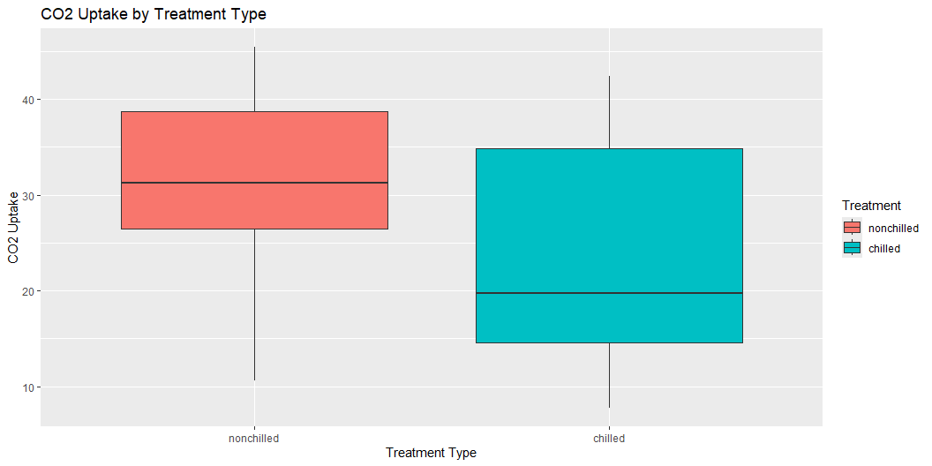
CO2 Uptake by Treatment

Slide 33
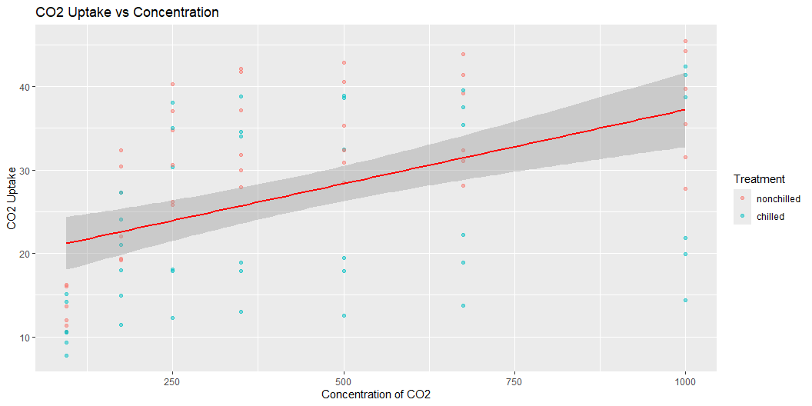
CO2 Uptake vs Concentration

Slide 34
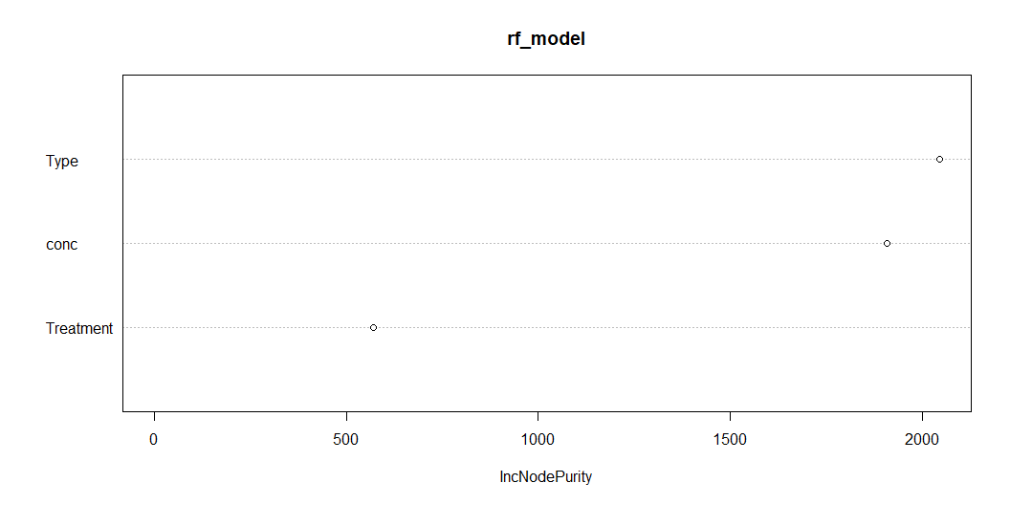
بناء نموذج التصنيف

Slide 35
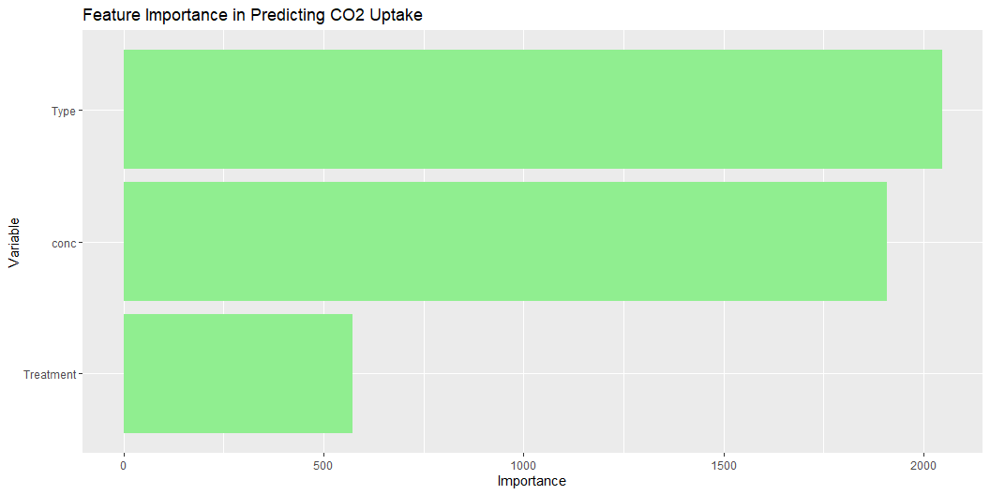
أهم العوامل المؤثرة

Slide 36
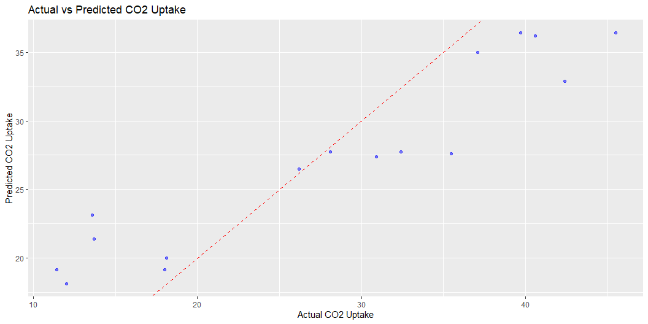
تقييم النموذج الإحصائي

Slide 37
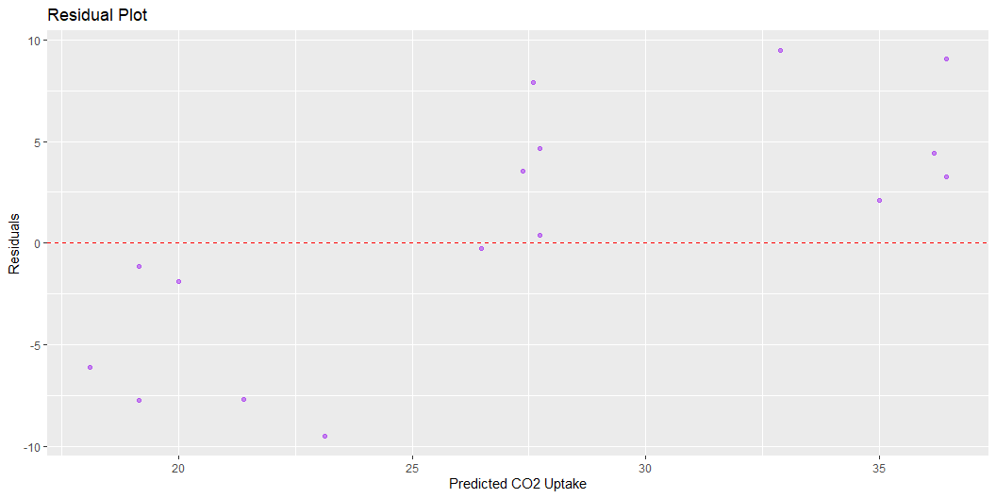

Slide 38
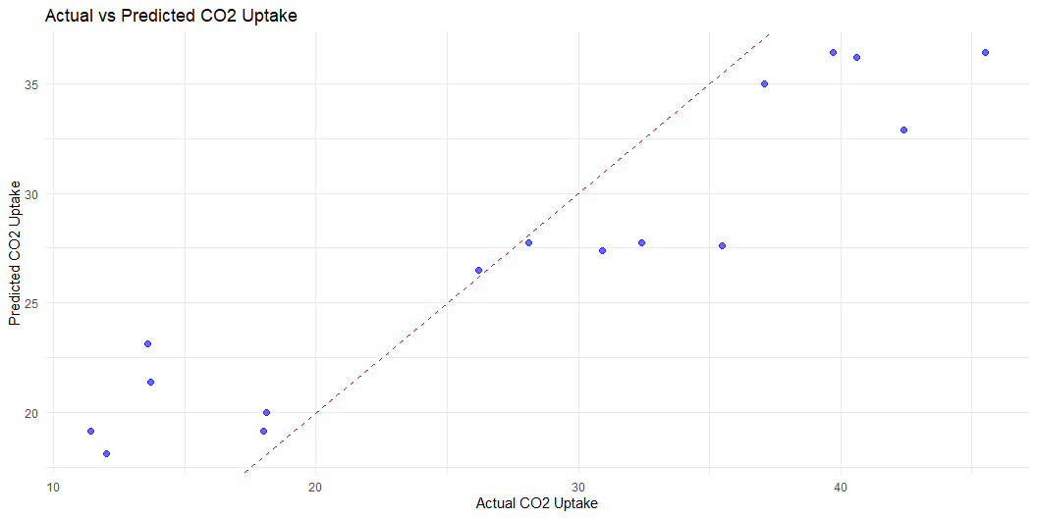
RMSE Rsquared MAE 5.8955656 0.8889256 4.9502591

Slide 39
مثال عام

Slide 40
بيانات مشاركة الدراجات
instant dteday season yr mnth hr holiday weekday workingday weathersit 1 1 2011-01-01 1 0 1 0 0 6 0 1 2 2 2011-01-01 1 0 1 1 0 6 0 1 3 3 2011-01-01 1 0 1 2 0 6 0 1 4 4 2011-01-01 1 0 1 3 0 6 0 1 5 5 2011-01-01 1 0 1 4 0 6 0 1 6 6 2011-01-01 1 0 1 5 0 6 0 2 temp atemp hum windspeed casual registered cnt 1 0.24 0.2879 0.81 0.0000 3 13 16 2 0.22 0.2727 0.80 0.0000 8 32 40 3 0.22 0.2727 0.80 0.0000 5 27 32 4 0.24 0.2879 0.75 0.0000 3 10 13 5 0.24 0.2879 0.75 0.0000 0 1 1 6 0.24 0.2576 0.75 0.0896 0 1 1

Slide 41
ملخص البيانات
instant dteday season yr Min. : 1 Length:17379 Min. :1.000 Min. :0.0000 1st Qu.: 4346 Class :character 1st Qu.:2.000 1st Qu.:0.0000 Median : 8690 Mode :character Median :3.000 Median :1.0000 Mean : 8690 Mean :2.502 Mean :0.5026 3rd Qu.:13034 3rd Qu.:3.000 3rd Qu.:1.0000 Max. :17379 Max. :4.000 Max. :1.0000 mnth hr holiday weekday Min. : 1.000 Min. : 0.00 Min. :0.00000 Min. :0.000 1st Qu.: 4.000 1st Qu.: 6.00 1st Qu.:0.00000 1st Qu.:1.000 Median : 7.000 Median :12.00 Median :0.00000 Median :3.000 Mean : 6.538 Mean :11.55 Mean :0.02877 Mean :3.004 3rd Qu.:10.000 3rd Qu.:18.00 3rd Qu.:0.00000 3rd Qu.:5.000 Max. :12.000 Max. :23.00 Max. :1.00000 Max. :6.000 workingday weathersit temp atemp Min. :0.0000 Min. :1.000 Min. :0.020 Min. :0.0000 1st Qu.:0.0000 1st Qu.:1.000 1st Qu.:0.340 1st Qu.:0.3333 Median :1.0000 Median :1.000 Median :0.500 Median :0.4848 Mean :0.6827 Mean :1.425 Mean :0.497 Mean :0.4758 3rd Qu.:1.0000 3rd Qu.:2.000 3rd Qu.:0.660 3rd Qu.:0.6212 Max. :1.0000 Max. :4.000 Max. :1.000 Max. :1.0000 hum windspeed casual registered Min. :0.0000 Min. :0.0000 Min. : 0.00 Min. : 0.0 1st Qu.:0.4800 1st Qu.:0.1045 1st Qu.: 4.00 1st Qu.: 34.0 Median :0.6300 Median :0.1940 Median : 17.00 Median :115.0 Mean :0.6272 Mean :0.1901 Mean : 35.68 Mean :153.8 3rd Qu.:0.7800 3rd Qu.:0.2537 3rd Qu.: 48.00 3rd Qu.:220.0 Max. :1.0000 Max. :0.8507 Max. :367.00 Max. :886.0 cnt Min. : 1.0 1st Qu.: 40.0 Median :142.0 Mean :189.5 3rd Qu.:281.0 Max. :977.0

Slide 42
تنظيف البيانات
season yr mnth hr holiday weekday workingday 0 0 0 0 0 0 0 weathersit temp atemp hum windspeed cnt 0 0 0 0 0 0

Slide 43
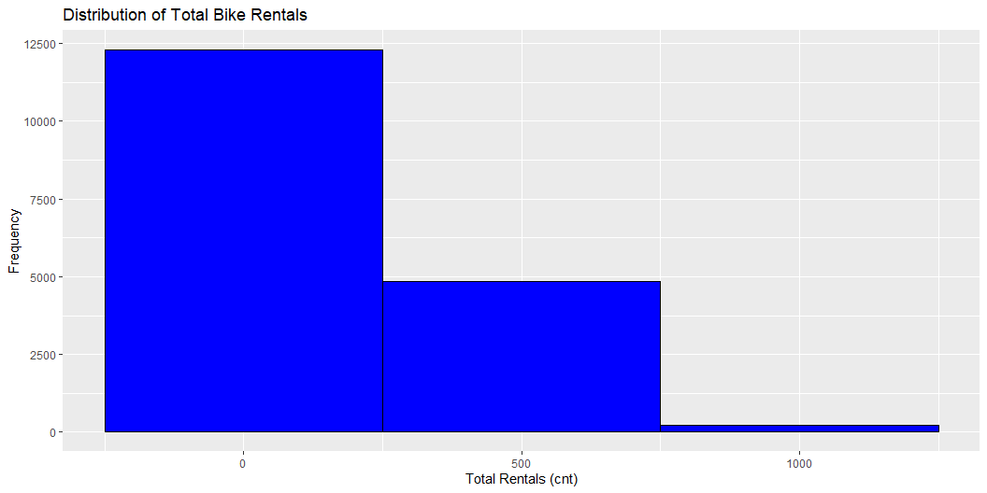
تصوير البيانات
Distribution of the Target Variable (cnt)

Slide 44
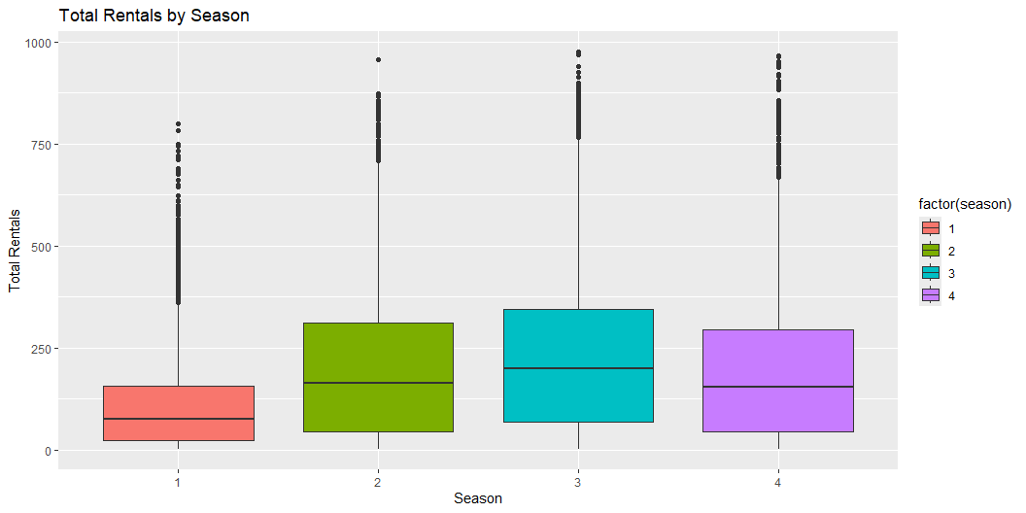
Seasonal Effect on Rentals:

Slide 45
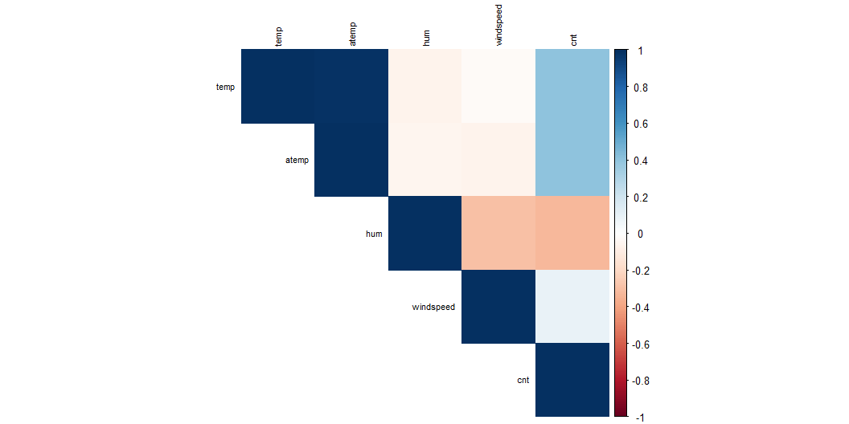
Correlation Matrix

Slide 46
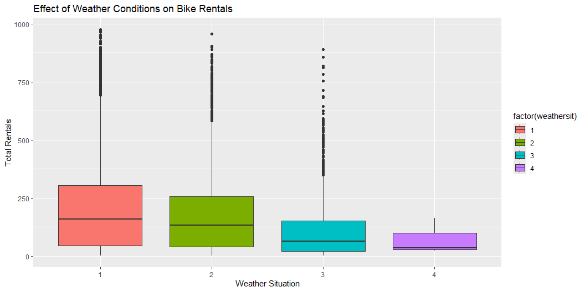
Weather Condition Effect

Slide 47
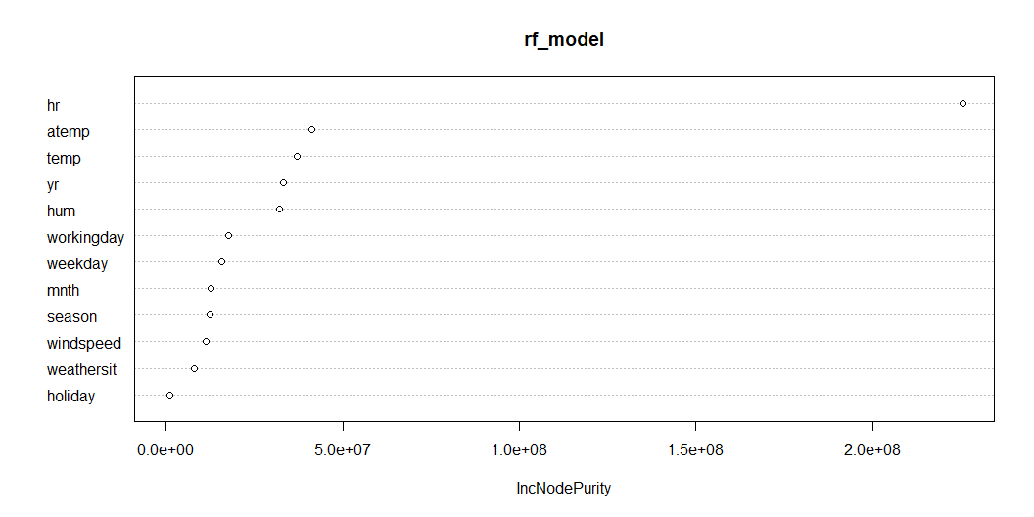
بناء نموذج التصنيف

Slide 48
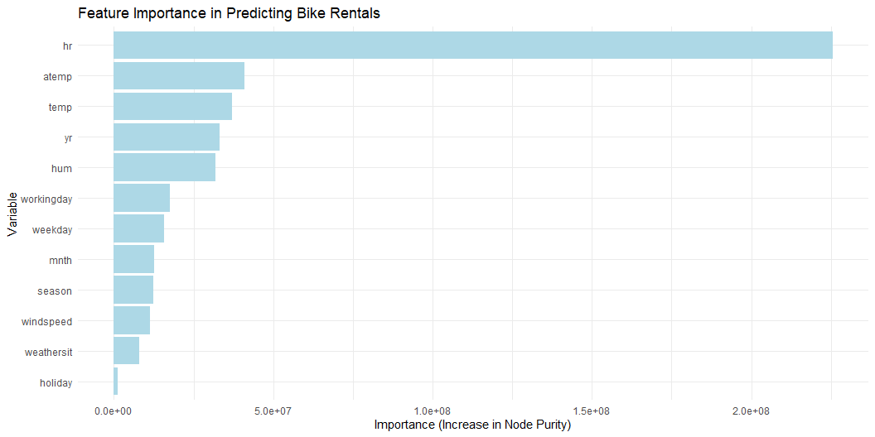
أهم العوامل المؤثرة

Slide 49
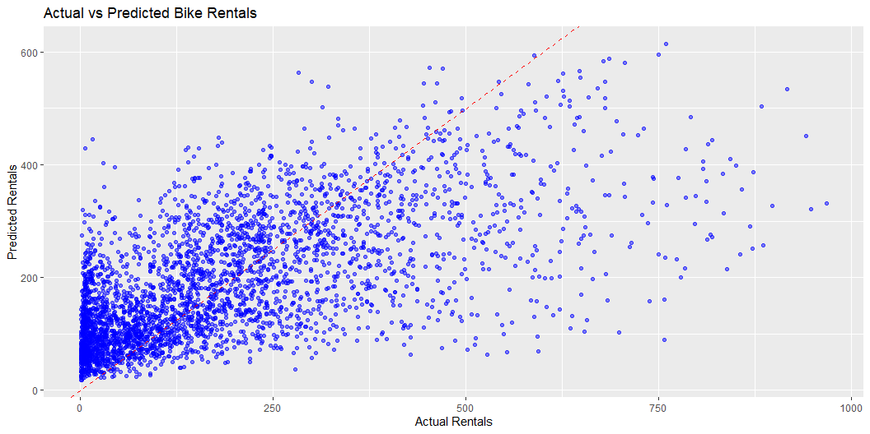
بناء نموذج تنبؤي
Call: randomForest(formula = cnt ~ temp + atemp + hum + windspeed + season + weathersit + weekday + workingday, data = train_data) Type of random forest: regression Number of trees: 500 No. of variables tried at each split: 2 Mean of squared residuals: 20434.6 % Var explained: 38.18
تقييم النموذج الإحصائي

Slide 50
RMSE Rsquared MAE 137.2632360 0.4169805 98.9536853

Slide 51


Slide 52


